Slide 1
The Big Help Out 2024 Using the campaign to boost volunteer recruitment April 2024
Notes:
ABOUT THIS RESOURCE
This slide deck is part of the with BHO VCSE Resource Pack – a suite of documents, templates and links designed to help voluntary and community sector organisations to engage with the BHO campaign
These slides are designed to help you hold an internal conversation about the campaign, supporting you to decide how and where you wish to engage
The intended learning outcomes are:
To gain a clear understand of the campaign, it’s purpose and how it works; and
To identify elements of the digital platform and media campaign that can add value to your work, and how to access them

Slide 2
INTRODUCING THE BIG HELP OUT
Covering
The campaign’s essential elements and objectives
Governance and timescales
How we know it works
Key volunteer audiences
The opportunity for VCSEs
Notes:
ABOUT THIS SECTION
In this section we cover:
The campaign’s context, it’s intended targets and what it seeks to achieve
It’s governance model
The key campaign timeline
The results and impacts of the 2023 campaign
DISCUSSION POINT
At the end of this section you’ll be able to have a conversation about the campaign objectives most relevant to your organisation and volunteering needs

Slide 3
Overview What is the campaign seeking to achieve?
Context: Millions of people volunteered during the pandemic, but we’ve seen a significant decline in volunteer numbers since. BHO is an attempt to respond to this challenge.
Objectives: To raise awareness of volunteering throughout the UK, provide opportunities for people to experience volunteering, and make a difference in their communities
When: BHO returns from Friday 7 to Sunday 9 June 2024, at the end of Volunteers' Week.
Notes:
Suggested discussion points:
Has your organisation experienced a drop in volunteers since the pandemic?
If so, take this opportunity to qualify or quantify this with your colleagues
What kind of reduction can you estimate?
Is there any pattern to the types of volunteers you have lost?
Do you have any reliable information as to why they have withdrawn?
And are any of these factors within your ability to control? List them.
The BHO weekend takes place at the end of Volunteers Week in June (Mon 3rd – Sunday 9 June)
At the current time, what resources (staff, volunteers and wider capacity) do you have available to take part?

Slide 4
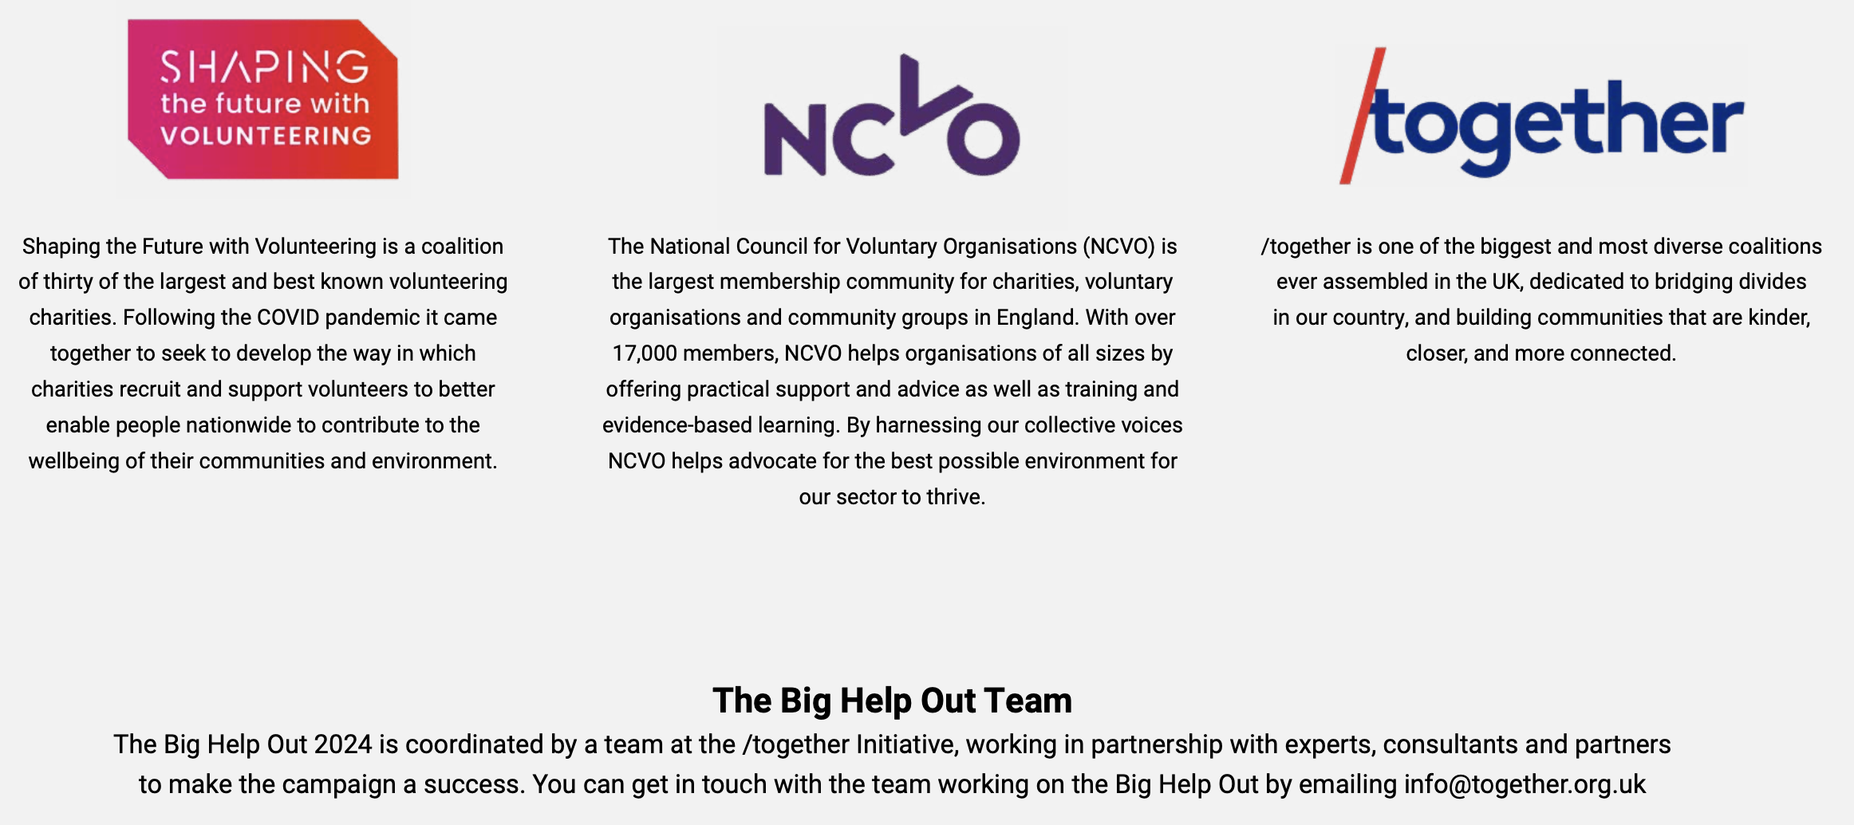
Governance Who is behind the campaign?
Supports the VCSE sector to engage
Co-ordinates the media campaign and key operations
Steers the campaign’s direction and objectives
Notes:
The BHO is funded through central government and key campaign partners (including Asda and DPD).
Participation has no financial cost – for VCSEs or the public.
It is led by the following Partnership:
Shaping The Future with Volunteering
A coalition of 30+ major national VIOs, collaborating since Covid
They conceived the campaign and will be offering many opportunities nationally
They are likely to have high profile roles in the media campaign
Collectively, they form a steering group for the campaign – a key audience
Convened by Jez Hughes: jez.hughes@bettercommunities.co.uk
More information: https://www.royalvoluntaryservice.org.uk/about-us/our-impact/charity-partners/shaping-the-future-with-volunteering/
/Together
A cross-sector coalition dedicated to building bridges between communities
Together runs a number of campaigns, including BHO and Thank You Day (7th July)
The staff team at /Together organise and co-ordinate BHO, especially the media campaign
More information: https://together.org.uk/
NCVO
The largest membership body for charities in England – with equivalent organisations in the UK nations
Championing volunteering is a key role, through data, research, training – hosts Vision for Volunteering
NCVO host this support package for VCSE engagement
More information: https://www.ncvo.org.uk

Slide 5
How does it work?
BHO ACTIVITIES?
Events, Actions, Ongoing Opportunities? Watch our video explainer.
Key Campaign Elements
A high-profile media campaign inspiring people to help out, building to a national call to action on BHO weekend (7-9 June)
A public-facing digital platform - a one stop shop (app and web browser) providing a clear, simple user journey to find and sign up for activities
Activities provided by Volunteer-Involving Organisations – events, actions and ongoing roles, available over BHO weekend and throughout the summer.
The role of VCSE organisations
Create and upload your BHO activities giving the public great choice and opportunity
Use the campaign and BHO weekend to attract a new audience to your cause, giving them a great experience and encouraging them to return.
Notes:
Event NOTES:
The media campaign is designed to address some perennial barriers for volunteers, such as not knowing they were needed, or when or where they were being asked to volunteer
The digital platform is designed to address others, such as not know where to go to find out about volunteering, or having to navigate multiple sites
On using the app or browser version, the public enter their preferences (causes, type of activity, availability, geography and other filters) to receive their own personalised search results
KEY MESSAGES
The media campaign will build an audience
The digital platform provides the mechanism to bring that audience to VCSE groups
VCSEs are responsible for the supply of opportunities and the volunteer’s experience once they take part in something
BHO Activities Video: insert link when hosted.

Slide 6
Shaping the Future with Volunteering? 30+ National Volunteer-Involving Organisations, driving the campaign
IN YOUR AREA?
Check out what activities these national groups might be running in your area, for inspiration.
Notes:
FOR INFORMATION
These are the Shaping the Future with Volunteering members
If you have any in your area, check out what they are planning for this year’s BHO

Slide 7
Focus of the campaign What The Big Help Out seeks to achieve in 2024
SCALE - empowering millions to volunteer and building a legacy from 2023
SUSTAINABILITY - empowering and enabling organisations to convert one-off volunteering into sustained engagement
TARGETING - reaching under-represented and diverse communities who need extra help to volunteer
Notes:
WHAT IS THE BIG HELP OUT SEEKING TO ACHIEVE?
Scale – this is a national (UK-wide) campaign seeking to reach millions
Sustainability – the media campaign builds to a key focus on one weekend, but the aspiration is to give these audiences a great experience and help them become longer term supports and volunteers
Targeting – the campaign has a particular focus on reaching those traditionally less likely to volunteer

Slide 8
Notes:
WHAT ARE THE CAMPAIGN’S KEYTIMESCALES
Launched in January
February – platform open to VCSEs to create or reactive accounts and upload opportunities
Feb – May: key platform development work – check in regularly to learn about new features
March/April: thematic, sectoral launches with partners in faith, education, food and other key areas
Mid April: platform opens to public, individuals have the first chance to register for activities
April/May: building of the public campaign across broadcast, print and social media
June 3-9: Volunteers’ Week, reflected and amplified in BHO comms activity
June 7-9: BHO weekend, the campaign’s peak moments with public attention like to be strongest
End August: digital platform closes for 2024

Slide 9
Results and impact 2023 How do we know it works?
RESPONDING TO VOLUNTEERING’S TOUGHEST CHALLENGES ?
Building a new audience for volunteering
Providing great choice and opportunity to help out
Helping the public have a great experience
Notes:
Does the campaign work? Results from 2023
If the campaign’s job is to create an audience, in 2023 an audience was created
7m+ told us they took part, 1 in 3 Brits had heard about BHO
VCSEs got involved at scale – 35,000 used the platform
Individuals told us they were more likely to volunteer again, and met people from different backgrounds
Sources:
This data is based on national polling (undertaken by Walnut) taken in the immediate aftermath of BHO 23 (May 23)
https://walnutunlimited.com/

Slide 10
Impact 2023: what did VCSEs say?
17% reported securing new, regular volunteers through the campaign
Of these, nearly half (49%) reported some or a lot of diversity amongst the new group, compared to their existing cohorts
Source: Internal BHO polling through the digital platform, powered by DoIt.Life
N=144, 86% of respondents were VCSE organisations (64% local, 12% national, 7% infrastructure)
Notes:
What about longer term impact? Six months on (October 2023) internal polling revealed:
Nearly a fifth or organisations reported repeat volunteering
And within these, around half reported good diversity of new volunteers, compared to their typical cohort
Conclusions? Some cautiously encouraging findings, though relatively small sample size
Sources:
Internal polling, conducted through DoIt
Respondents were selected selecting and not weighted/sampled

Slide 11
Impact 2023: what did volunteers say?
80% - no prior relationship with the org/cause with whom they signed up (new audience)
40% - done no other volunteering in the past year (not all usual suspects)
71% of all who signed up went on to take part as planned (conversion)
34% of participants went on to volunteered again with the same org (conversion)
53% of all those who signed up volunteered since BHO23 (inspired)
76% said they would likely take part again next year (satisfaction)
Learning points?
of those that had not returned to volunteer since, 33% said they still planned to (but it hadn’t happened yet) (VIO comms and planning)
21% of those unlikely to take part in 2024 cite having a negative experience at BHO23 (joint top answer) (experience)
Source: Internal BHO polling through the digital platform, powered by DoIt.Life. N=309.
Notes:
What about longer term impact? Six months on (October 2023) internal polling revealed:
Volunteers were generally positive in their responses
Telling us a range of things about the impact of the campaign on reaching a new audience, converting willing into participation and likelihood to volunteer again
And within these, around half reported good diversity of new volunteers, compared to their typical cohort
Learning for VCSEs includes paying close attention to timely communications and volunteer experience
Sources:
Internal polling, conducted through DoIt
Respondents were selected selecting and not weighted/sampled

Slide 12
What kinds of volunteers is BHO targeting? Reaching and inspiring irregular and informal volunteers (grey, orange, yellow lines)
Post London 2012
Covid era
Source: DCMS Community Life Survey
Notes:
Community Life Survey data illustrates the challenging context for volunteer recruitment and retention
But the data also reminds us there are four main types of volunteering that we measure
We may be most interested in formal, regular volunteers – the blue line
But there are other types – informal and irregular – and we find greater numbers volunteering in these ways
The Big Help Out is designed to reach those on the orange, grey and yellow lines – as well as people not on any lines (non-volunteers)
The campaign seeks to inspire them, the platform seeks to give them am easy route in
The Big help Out is here to help us build a pipeline of new potential (formal and regular) volunteres

Slide 13
An opportunity for VIOs
! DISCUSSION POINT !
Which of these mirror your own objectives?
To reach a potential new audience of volunteers in a tough recruitment and retention climate
An opportunity to target under-represented communities and/or increase diversity in volunteering, with national campaign assets
Add value to your Volunteers’ Week engagement, creating a bridge between celebration and recognition and your recruitment pathways.
Notes:
THREE REASONS TO GET INVOLVED
Firstly – an opportunity to reach a potential new audience
Secondly – if you share the ambition to reduce barriers and diversify volunteering, this is a great time to put some resource behind it
And thirdly – the BHO can provided added value to any Volunteers’ Week activity you’re already considering (more on this later)
DISCUSSION POINT
Which of these reasons is the most important for your organisation?
Can you agree on some concrete objectives under one or more? What would you like to achieve?

Slide 14
ENGAGING UNDER-REPRESENTED COMMUNITIES
Covering
How the campaign is approaching this, and how VCSEs can too
Who is under-represented? What does the data tell us?
Younger volunteers and those living in more deprived areas
Using the Vision for Volunteering
Using Time Well Spent, to plan your engagement approaches
Notes:
In this section we’ll look at the campaign’s focus on under-represented communities
Which communities, and how?
And we’ll consider what this question might mean for VCSE organisations
You may already have communities you wish to target, or you may not have identified these yet
How can national data help us to agree on targets
And how can research help us create the best possible approach for reaching them?

Slide 15
Under-represented communities, increasing diversity in volunteering
The BHO Campaign is focusing on…
Younger volunteers – 25-34s are less likely to volunteer generally, but the 18-34s combined are more likely to participate in BHO
Areas of deprivation: particularly those in receipt of Know Your Neighbuorhood funding
Suggested VCSE approaches
Use national data to help you identify under-represented communities,
Or use your own data, instincts and strategy to identify those under-represented or to increase diversity amongst your audiences
National research insights can help you develop your approaches to engaging them
Notes:
The campaign (media elements) will seek to reach:
younger volunteers, which campaign data shows respond well to the BHO
And those in areas of deprivation
KNY is a £30-million package of funding designed to widen participation in volunteering and tackle loneliness in 27 disadvantaged areas across England
https://www.gov.uk/guidance/about-the-know-your-neighbourhood-fund
VIOs can
Mirror the campaigns’ approaches and key audiences, piggybacking on media activity
Or take your own approaches to increasing diversity
National data and research can help you both identify targets and plan you approaches
KNY areas
Barnsley
Barrow-in-Furness
Blackpool
Bolsover
Burnley
Cannock Chase
County Durham
Doncaster
Fenland
Great Yarmouth
Halton
Hartlepool
King’s Lynn and West Norfolk
Kingston upon Hull
Knowsley
Middlesbrough
Rochdale
Sandwell
South Tyneside
Stoke-on-Trent
Sunderland
Tameside
Tendring
Thanet
Torridge
Wakefield
Wolverhampton

Slide 16
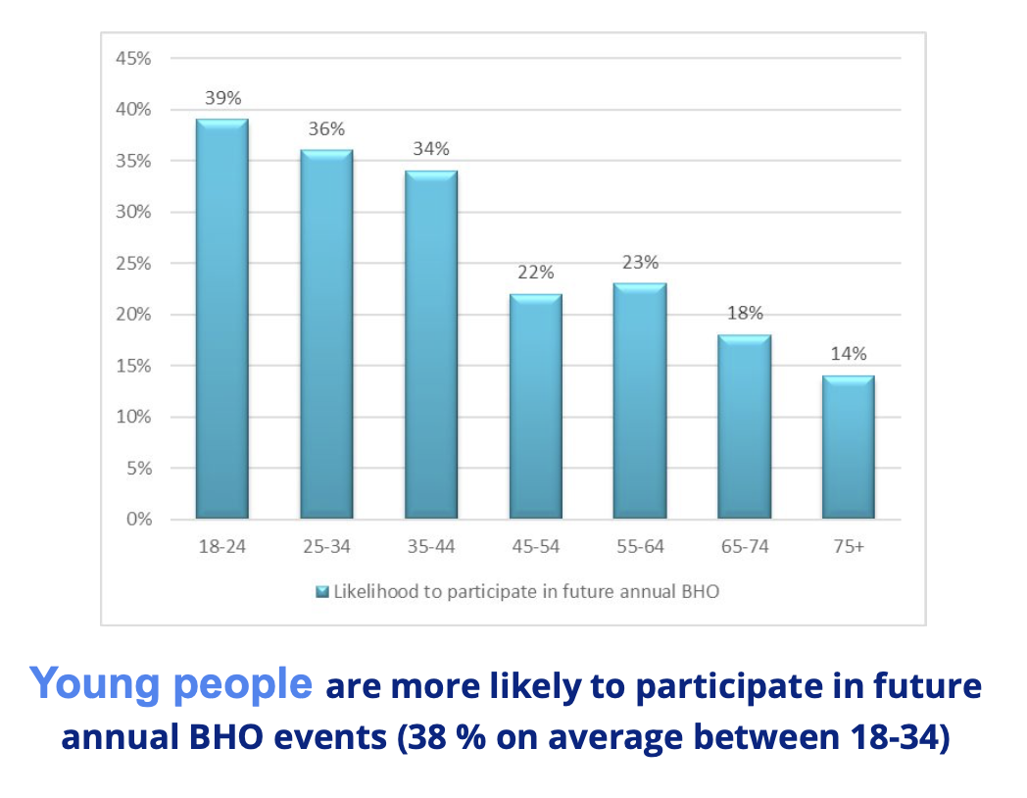
Younger volunteers at TBHO23
…but at last year’s Big Help Out, younger volunteers were the most likely to engage.
Younger volunteers were a significant chunk of 2023 campaign participants - 22.5% were aged 18-34
Younger volunteers also revealed they were most likely to participate in 2024 (graph)
The Big Help Out represents a particular opportunity to engage younger volunteers.
Source: BHO polling (Walnut) 2023. Please seek agreement with /Together before using any of this data in public.
Notes:
Younger volunteers represented a significant proportion of those that took part in 2023
And have indicated that they are more likely than other groups to take part in 2024

Slide 17
Volunteering: who is under-represented?
In one area national data is consistent:
Rates of volunteering appear to track economic capital
Volunteering is more likely in more more affluent areas, less likely in more deprived areas
Distribution of charities (and mutual aid groups during the pandemic) follows a similar pattern
The ability to volunteer may be linked with economic (and perhaps also social) capital
Notes:
If some CLS data reveals a mixed picture, other sets are more definitive on this question
Economic inequality is one such lens
Those living in more deprived areas are less likely to volunteer
Data on next slide

Slide 18
Volunteering and economic capital
! DISCUSSION POINT !
Source: DCMS Community Life Survey
Notes:
formal, regular volunteering measured by area, using the incidences of multiple deprivation as a filter.
This presents a clear and consistent trend, also reflected in irregular/formal volunteering.
From this we see that volunteering rates are higher in more affluent areas
people are more likely to volunteer (with groups and organisations) in less deprived areas.
DISCUSSION POINT
How might we seek to reach communities in areas of deprivation? Which of these strategies feel viable to us?
· By Prioritising outreach – where and how can we go to them, assuming they are less likely to have access to volunteering infrastructure?
· By designing opportunities with flexibility around time and expected commitment, reducing key barriers for those with less economic or social capital
· By ensuring volunteers are not out-of-pocket – offering and paying expenses, and proactively reassuring volunteers about this.

Slide 19
Vision for Volunteering
How can it help us consider how to reach and engage under-represented communities?
Use the new Toolkit to explore the five key themes and their relevance to your mission and objectives:
Awareness and appreciation
Power
Equity and Inclusion
Collaboration
Experimentation
VISION USERS SAY:
“Truly interesting conversations, new ideas and quality questions to keep exploring the future of volunteering and making it more accessible, impactful and inclusive!”
“There is such a powerful force of volunteer managers out there coming together to make meaningful change. It’s so exciting!”
Notes:
The Vision for Volunteering is a framework for helping us to understand how to adapt our practice to meet new trends in volunteering
Changes in volunteers’ typical behaviours, motivations, expectations, needs
The Vision’s five themes reflect these trends
And the new Vision Toolkit will help you to explore these five themes
And their relevance for your organisation
This can help you decide on a focus and target
Download it here: https://www.visionforvolunteering.org.uk/toolkit

Slide 20
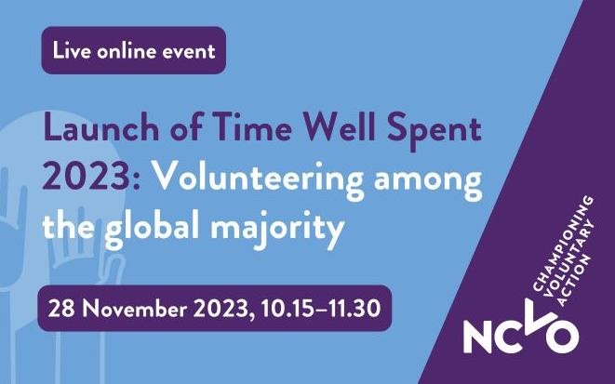
Time Well Spent: Global Majority
Gain insights into
the experiences and drivers for volunteers from the global majority
! DISCUSSION POINT !
How can we build insights from Time Well Spent into our engagement practices?
Notes:
NCVO’s Time Well Spent - a national survey on the volunteer experience
Its latest release focuses on the global majority
Non-white British volunteers
The following slides draw out some highlights, supporting our understanding of global majority volunteers at different stages of their journey
DISCUSSION POINT
On the slides that follow, consider how the insights might inform or change your current practices
Futher NCVO guidance on adapting your practice to the lessons identified in Time Well Spent Global Majority is available here:
https://www.ncvo.org.uk/news-and-insights/news-index/time-well-spent-2023-volunteering-among-the-global-majority/implications-for-volunteering-practice-and-policy/

Slide 21
PLANNING YOUR OFFER
Engaging enthusiastic non-volunteers
Focus on what motivates them (see next slide), considering how motivations relate to factors such as religion, cultural background or career aspirations. A person centered approach is key to inclusive volunteering.
Promote diversity within your organisation – consider how you can meaningfully showcase this in recruitment materials.
Review your volunteering strategy to ensure best practice is actively used – this should increase accessibility and address barriers.
INSIGHTS FROM TIME WELL SPENT
GLOBAL MAJORITY
Notes:
When planning our approach, what can we take from TWS?
How do these insights inform who we target and how we might approach them?

Slide 22
PLANNING YOUR OFFER
What motivates global majority volunteers?
They are most likely to be motivated by a cause that is important to them
They are more likely to be motivated by religious belief or career-related benefits
Global majority survey respondents (including non-volunteers) most value a culture of respect and trust (but are less likely to agree this exists where they volunteer now).
INSIGHTS FROM TIME WELL SPENT
GLOBAL MAJORITY
Notes:
When planning our approach, what can we take from TWS?
How do these insights inform who we target and how we might approach them?

Slide 23
PLANNING YOUR OFFER
Indications and insights about Global Majority volunteers
Likely to have a different concept of volunteering, due to cultural/religious backgrounds
Volunteering for a civil society organisation is most common, but global majority volunteers are more likely to volunteer in the public and private sector than others
Less likely to be involved in leadership roles in volunteering
More likely to be younger, more religious and live in urban areas, and much more likely to volunteer for a religious cause.
INSIGHTS FROM TIME WELL SPENT
GLOBAL MAJORITY
Notes:
When planning our approach, what can we take from TWS?
How do these insights inform who we target and how we might approach them?

Slide 24
ENGAGEMENT
What Global Majority volunteers say about their experiences
Higher expectations of the ease and speed of entry and induction processes
More likely to say recognition is important, but are less likely to say they feel recognised compared to volunteers overall
Much more likely to report that volunteering is becoming too much like paid work, with unreasonable expectations placed on them
One in five have skills and experiences they would like to use more, with black volunteers and those aged 35‒54 more likely to agree with this.
INSIGHTS FROM TIME WELL SPENT
GLOBAL MAJORITY
Notes:
What about the early stages – what should we pay attention to?
Things to avoid – lengthy inductions
Things to offer – opportunities to use their skills and experiences

Slide 25
ENGAGEMENT
What positively influences volunteering satisfaction?
Age and disability influence volunteer satisfaction more for global majority volunteers
A positive volunteering culture of respect, trust and appreciation is key to global majority volunteer satisfaction
Having a wide range of backgrounds is more important for global majority volunteer satisfaction compared to volunteers overall
Feeling that the organisation is ‘not going anywhere’ and tensions and conflicts are stronger negative factors.
INSIGHTS FROM TIME WELL SPENT
GLOBAL MAJORITY
Notes:
What about the early stages – what should we pay attention to?
They want to know you’re on a mission - share your impact with them, and how volunteers contribute

Slide 26
RETENTION
What factors support or inform our ability to do this well?
Just over two-thirds say they are likely to continue volunteering in the next 12 months. Younger volunteers, disabled volunteers and public sector volunteers are less likely to continue.
A sense of duty or obligation ranks more highly for global majority volunteers as a reason to continue.
INSIGHTS FROM TIME WELL SPENT
GLOBAL MAJORITY
Notes:
What about when they are engaged – what insights help us to retain them?
Retention - Connecting with a sense of duty

Slide 27
INCLUSIVITY
Overcoming barriers to volunteering
Main barriers are related to time and commitment.
Concerns about skills, worries they won't fit in, and not being aware of opportunities are ranked higher by global majority non-volunteers. (Disabled non-volunteers are much more likely to see not fitting in as a barrier).
Asian non-volunteers are more likely than other ethnic groups to be put off by other previous negative experiences.
Global majority non-volunteers are more likely to have considered volunteering in the last 12 months compared to non-volunteers overall, especially if it benefits their career or job prospects. They also value a quick and easy entry process.
INSIGHTS FROM TIME WELL SPENT
GLOBAL MAJORITY
Notes:
And what factors can best foster a sense of inclusivity?

Slide 28
ALIGNMENT WITH VOLUNTEERS’ WEEK
Covering
New dates for Volunteers’ Week in its 40th year
Aligning VW and BHO for greater campaign efficiency
A chance to bridge your recognition/celebration activity and recruitment objectives
Accessing the latest campaign news and assets
Notes:
This year the Big Help Out is aligned with Volunteers Week (3-9 June)
Taking place on the weekend of 7-9 June

Slide 29
Aligning with Volunteers Week How can we use this to our best advantage?
! DISCUSSION POINT !
Volunteers’ Week has moved – it now starts on the first Monday in June
Aligning VW and BHO – more efficient, two campaigns at the same time
Added value – linking celebration and recognition activity (VW) with recruitment objectives (BHO):
How? List your activities (events, actions or ongoing roles) on the BHO digital platform for a ’call to action’ to embed in your Volunteers’ Week comms activity, giving those inspired a clear message and way to get involved.
New brand, website and assets – check https://volunteersweek.org/ for details
Check UK Nations for details of activity in Wales, Scotland and Northern Ireland
Notes:
DISCUSSION POINT
Consider how you might best combine your VW and BHO activity for maximum impact
Think about what the ideal user journey might be for a new audience, hearing about you for the first time through your volunteer stories
How might you bring them in, through a Big Help Out event, action or ongoing role?

