Slide 1
National volunteering forum vision for volunteering: online launch 10 may 2022
@NCVO
#VolForum
#VisionForVolunteering
Notes:
WELCOME SLIDE
Hello and warm welcome to this mornings National Volunteering Forum for the online launch of the Vision for Volunteering.
I’m Nick, NCVO’s networks manager, and it’s great to see so many of you joining us online today
Over the past 12 months – many of you will have contributed toward the development and creation of the Vision for Volunteering that we'll hear about today.
You might have:
- attended one of the twelve workshops late last year
- taken part in interviews
- you may have conducted your own consultations with staff and volunteers, generating ideas for what you thought were important things that the Vision for Volunteering should take into account
And then
- some of you went all out and submitted a mini-thesis with your aspirations for the next 10 years for volunteering in England
However you may have contributed, your insight, your enthusiasm and your vast experience has been invaluable to this process.
Much more will be said about this in a moment – and if you tweet about todays event do tage
@NCVO – and use the
#VolForum
#VisionForVolunteering
but before we get to that – the all important housekeeping slides

Slide 2
Notes:
You’ll notice that closed captions – or subtitles – have been enabled.
To turn these on or off, please click on the CC icon in the tool bar at the bottom of the screen.
Today’s event isn't being recorded but we will circulate a copy of the slides with links to the things we mention shortly afterwards – and my colleague Noama will also be writing a blog to summarising the event and the feedback you give .
With microphones, please keep these muted during the presentations
And it’s up to you if you have your cameras on or off, but having them turned on in the breakout discussion a little later could help the conversation to flow.
You can add any comments and reflections around the things that you hear today into the chat
And this is where you can also post any questions you have about the Vision, which we’ll gather together ready for the Q&A toward the end of the session.
Finally
We'll have a ten minute break today just after 11 o'clock, but if you need to step away from your screen for any reason, please feel free to do so

Slide 3
National volunteering forum
Vision for volunteering online launch
10.00 Welcome and housekeeping
10.10 Introducing the Vision for Volunteering
10.30 Reflections from the voluntary sector
11.00 Break
11.10 Group discussions
11.35 Q&A
11.55 Close
Notes:
In just a moment I'll be handing over to Sarah Vibert – CEO of NCVO, and Paul Reddish, the CEO of Volunteering Matters to introduce to you the Vision for Volunteering.
Both Sarah and Paul have been members of the Steering Group who have guided development of the project over the past 12 months
We’ll then hear some initial reflections from the sector on the Vision for Volunteering
We have three guest speakers, that my colleague Jarina Choudhury will welcome and introduce:
First up we have Rubel Ahmed, development officer at the Active Communities Network
Second, we'll be welcoming Amy Collins, Volunteering Development Lead at Community Action Network
And closing this section will be
KUNLE ou-lu-luday (OLULODE) the director from voice for change.
We'll aim for a break at around 11am – a chance to step away from your screens, stretch your legs, grab a coffee
Before coming back to discuss the five thematic areas of the vision for volunteering,.
Together, we’ll share ideas for how we can bring these five themes alive and embed them within our organisations and our ways of working. This section will be introduced by my colleague Catherine Goodall.
On point on this
On the email with the joining instructions, we asked which of the five themes you'd be most interested in discussing – if you didn’t fill out this poll to state your preference, do message my colleague Chanel via the chat and let her know which group you'd like to join.
If not you'll be allocated a group at random.
The final section for the todays event will be a q&a with members of the steering group and working group – Jenny Betteridge from Sport England, Ben Grady from DCMS and Jarina Choudhury from NCVO - any questions that you have about the vision, please pop these in the chat and they'll be collated together
All being well, we should be wrapping up the event just before midday.

Slide 4
Introducing the vision for volunteering
Sarah Vibert, CEO, NCVO
Notes:
https://www.visionforvolunteering.org.uk/the-vision
So, to introduce the Vision for Volunteering – I'm pleased to hand you over to two of the steering group members:
First, we’ll hear from
Sarah Vibert, the chief executive at NCVO,
And then Sarah will be followed by
Paul Reddish, the chief executive at Volunteering Matters .
But to kick things off this morning – Sarah, over to you

Slide 5
Vision for Volunteering
Why develop a Vision for Volunteering?
Covid has widely demonstrated the power of volunteering
Covid has accelerated changes in volunteering
Volunteering benefits the individual – and society
Not everyone is able to volunteer equally.
Not everyone who volunteers has a positive experience.

Slide 6
Vision for Volunteering
How did we get here?
Steering group of voluntary organisations, government and public serices
14 workshops
350 people
43 written submissions

Slide 7
Vision for Volunteering
How did we get here?
Notes:
.

Slide 8
Vision for Volunteering
NCVO’s roles

Slide 9
Introducing the vision for volunteering
Paul reddish, ceO, volunteering matters
Notes:
https://www.visionforvolunteering.org.uk/the-vision
So to kick things off – and introduce the Vision for Volunteering – I'm pleased to hand you over to two of the Vision for Volunteering steering group members:
Sarah Vibert, the chief executive at NCVO,
And
Paul Reddish, the chief executive at Volunteering Matters .

Slide 10
Vision for Volunteering
What are we Trying to achieve?
We want to see power shift and change over the next ten years, drawing on and building power in communities, groups and for volunteers.
We want volunteering to be accessible and welcoming for everyone.
We want collaboration to be at the heart of volunteering. We will work together to build a better future.
We want experimentation to be a natural part of volunteering.

Slide 11
Vision for Volunteering
What next?
This is just the start of our work to build a better future for volunteering.
We want groups and organisations across the country to come together, to take a lead on creating change.
We will work together to define the next phase of the Vision, setting out how we can make this future a reality over the next ten years.

Slide 12
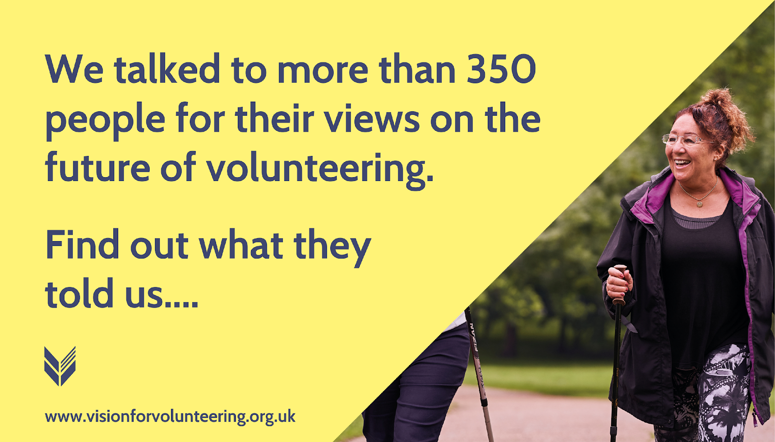

Slide 14
Vision for volunteering
Reflections from the sector

Slide 15
Active communities network
Rubel Ahmed
Development manager

Slide 16
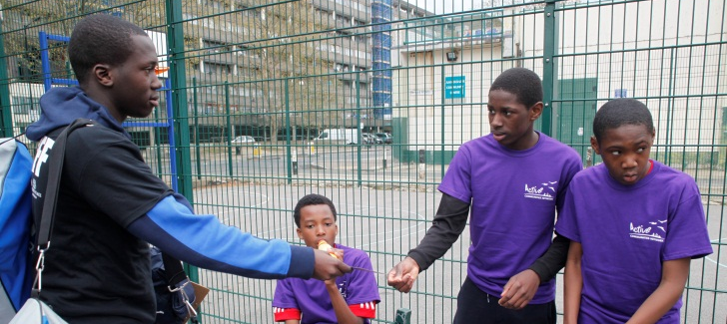
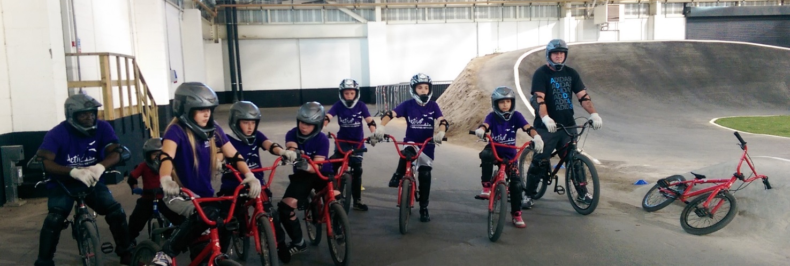
What does the work look like?
Outreach and Detached work
Community Sports
Personal /Social Development
Accredited training
Employability through volunteering, citizenship & social action

Slide 17
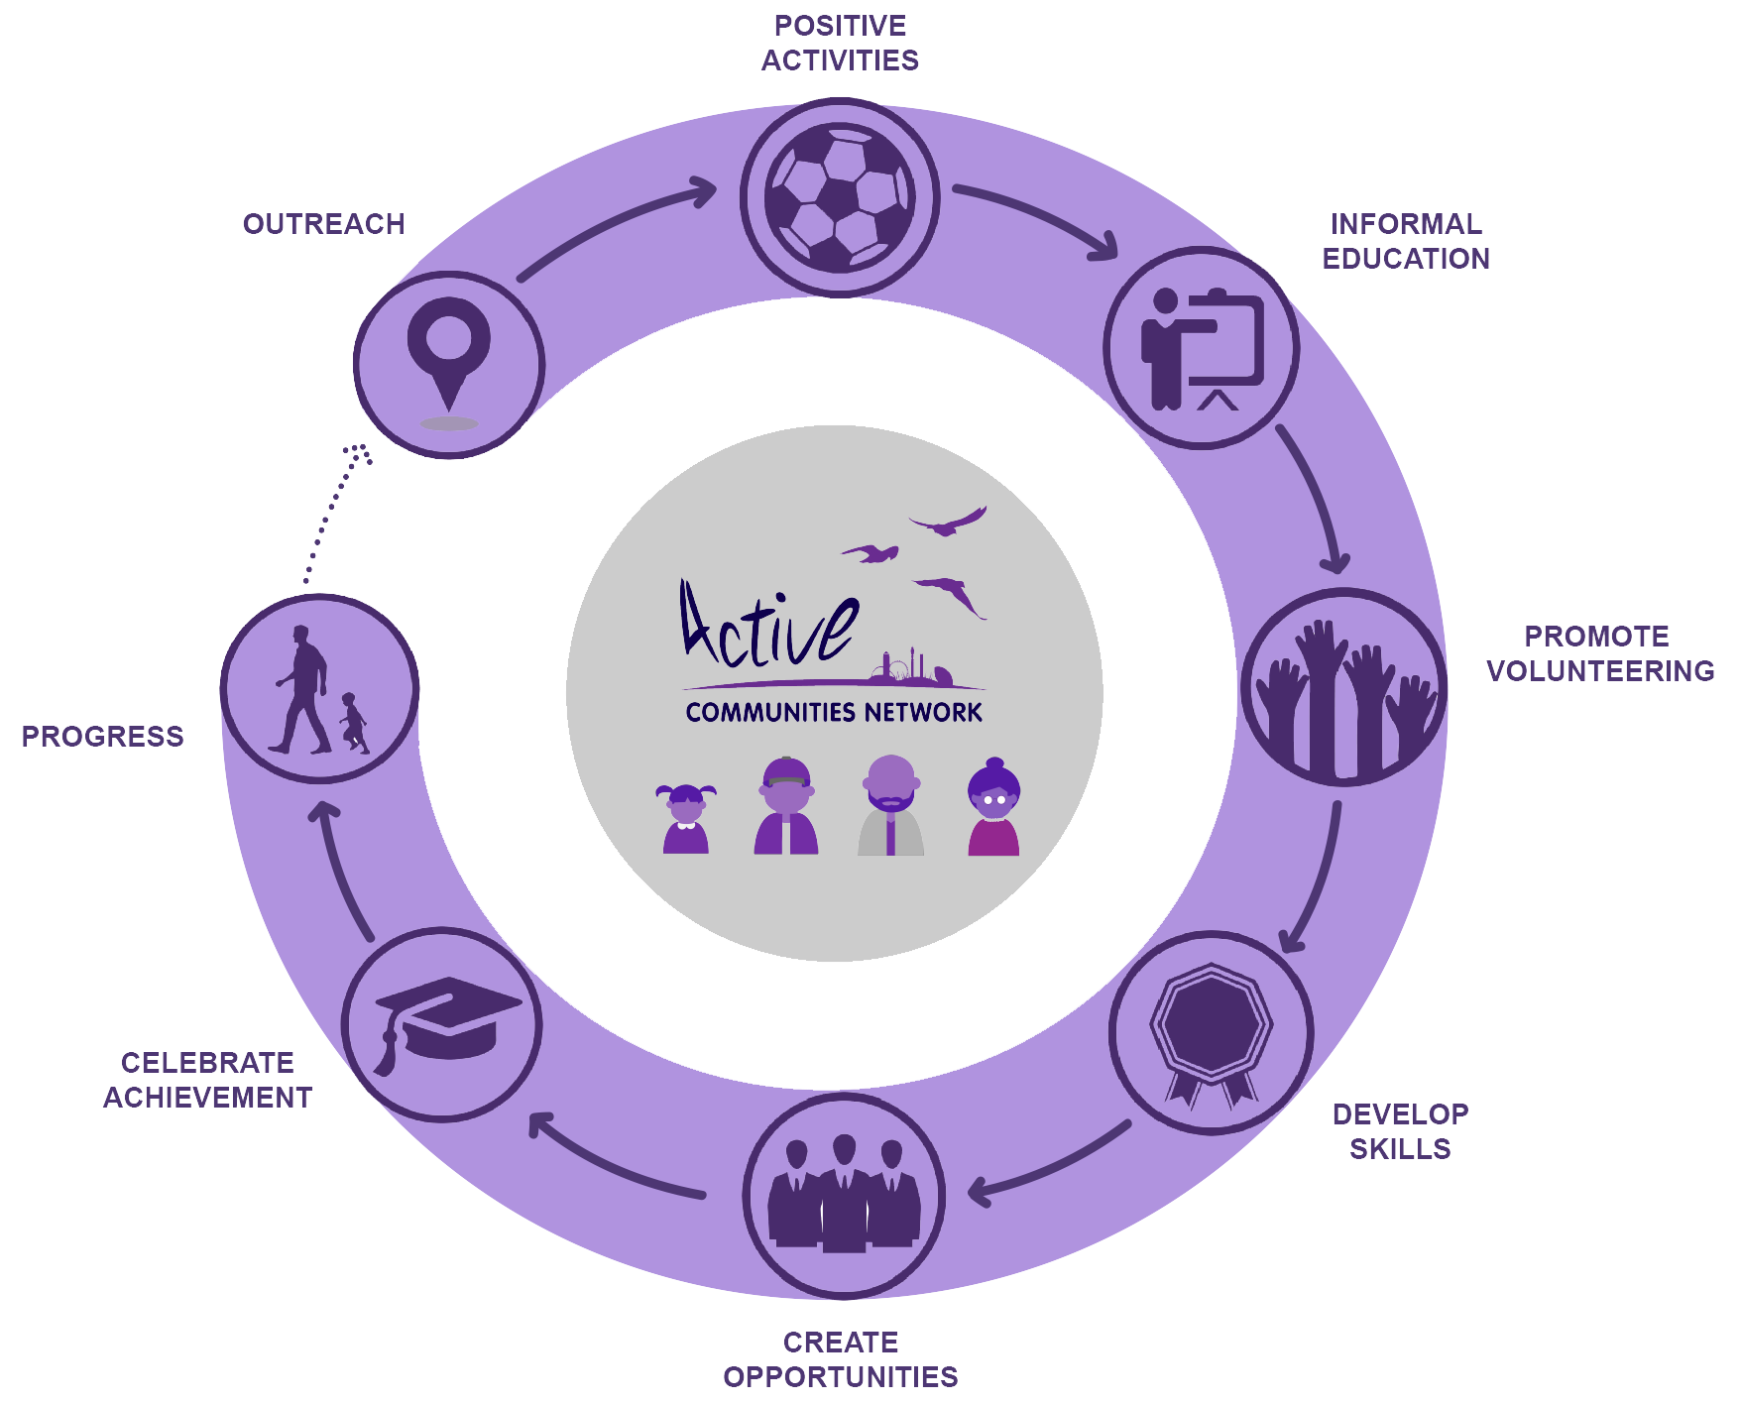
ACN Participant journey
Notes:
Explaih journey and then talk about how mentoring is implicit throughout

Slide 18
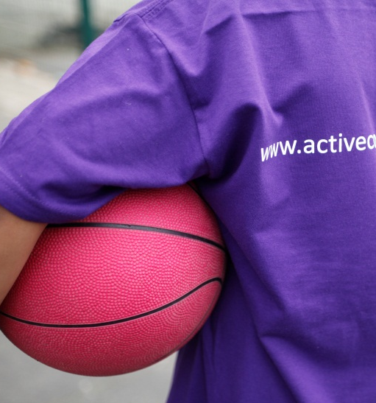
Volunteer Programmes
Funders set outcomes based on assumptions. Breaking barriers addresses assumptions by creating a new set of assumptions based on the understanding of cultural sensitivity and a volunteer centred approach.

Slide 19
Adaptability
Adaptability is a major key 🔐 to developing community especially in these challenging times.
Leadership
The leadership journey identifies visible and invisible barriers to development for both the individual & communities they belong to, whilst creating pathways and solution for the challenges ahead.
Connect Networks
Loosely connected networks develop stronger outcomes.
A bottom-up focus with volunteers supports a consortium lead approach.

Slide 20
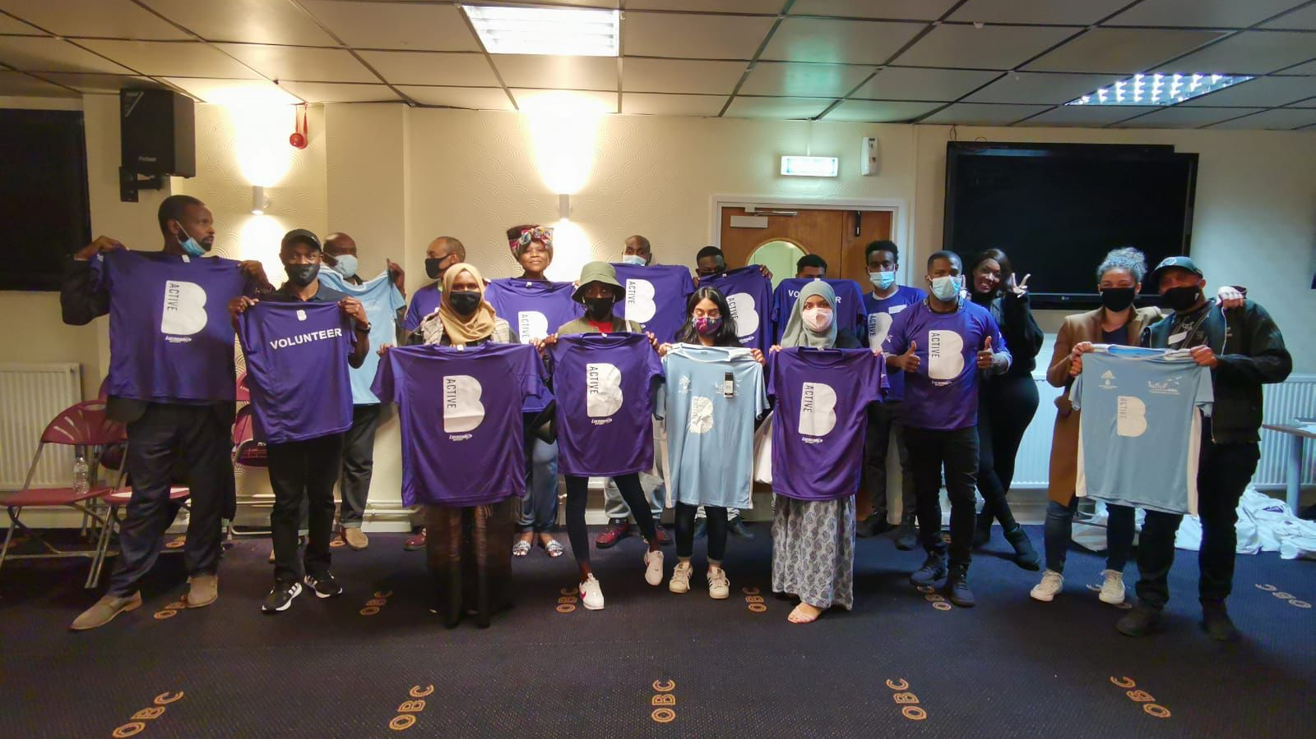
Culture
Culturally we have an ethos of volunteering.

Slide 21
Community action network
Amy collins
Volunteering development lead

Slide 22
Vision for volunteering
Reflections from the sector
Many of us are already in (or working towards) Horizon 2 as a result of the shake up to volunteering that occurred during the pandemic. By sharing and equipping us and VCS organisations with the skills, knowledge and support needed, we can move together to Horizon 3, where volunteering becomes the norm for everyone.
We need to build on the momentum that occurred during the pandemic. This Vision will ensure we continue experimenting, and looking at new ways to deliver services and involve more volunteers from more walks of life.
The vision resonates with us and what we want to achieve which is that we want to open up volunteering to everyone, so we all have the chance to collaborate, have power, and shape the look of local services.
Steps for Voluntary Sector to take
Recognise that everyone has something to offer, even if doesn’t fit the vision of the right / perfect volunteer. Take a chance and involve them!
Notes:
The below are only suggestions to get you thinking – in 5-8 minutes it would be impossible to cover all of this and we want to inject your reflection with your own personality, enthusiasm and relevance
Were you involved in contributing toward the Vision for Volunteering – why was it important to input to its development?
Which aspects of the Vision for Volunteering are you most excited about?
Why is now the right time for the sector to have a Vision for Volunteering to work toward? What do you hope it will achieve?
There are five themes within the vision – power, collaboration, experimentation, equity and inclusion and volunteer experience.
Which are you drawn to?
How will having these five themes in the Vision for Volunteering support your work?
How will you, your organisations and volunteers be able to help make the vision a reality? On a first read, what ideas do you have? What commitments do you hope to make?
What steps would you like to see the voluntary sector taking to support the vision? If you had a call to action to others, what would it be?

Slide 23
Voice4change england
Kunle olulode
director

Slide 24
Vision for volunteering
Reflections from the sector: Voice4change england
My first volunteering role BBC Broadcasting Support Services.
BME sector has a large body of volunteers that aren’t recognised; government data backs this up.
Our vision is the creation of comfortable space in which a more diverse range of volunteers can operate.
I really like the way that cultural organisations like the V & A, English Heritage Trust have tried to innovate.
In summary – what successful volunteering looks like to our networks.
Notes:
The below are only suggestions to get you thinking – in 5-8 minutes it would be impossible to cover all of this and we want to inject your reflection with your own personality, enthusiasm and relevance
Were you involved in contributing toward the Vision for Volunteering – why was it important to input to its development?
Which aspects of the Vision for Volunteering are you most excited about?
Why is now the right time for the sector to have a Vision for Volunteering to work toward? What do you hope it will achieve?
There are five themes within the vision – power, collaboration, experimentation, equity and inclusion and volunteer experience.
Which are you drawn to?
How will having these five themes in the Vision for Volunteering support your work?
How will you, your organisations and volunteers be able to help make the vision a reality? On a first read, what ideas do you have? What commitments do you hope to make?
What steps would you like to see the voluntary sector taking to support the vision? If you had a call to action to others, what would it be?

Slide 25
Break – 10 mins

Slide 26
Group discussions
Notes:
So, welcome back everyone. I hope you had a nice break.
For anyone I haven’t met before, I’m Catherine Goodall, the Senior Policy and Influencing Advisor at NCVO. I have been lucky enough to be on the working group for the Vision, so have been able to see it grow and develop.
I’ll now introduce the next part of the session.

Slide 27
Group discussions
We will have 15 minutes in our groups.
For each breakout, there is a question relating to each theme (which your facilitator will introduce).
We will be using Jamboards to capture notes, feedback and thoughts.
Notes:
We will shortly move into smaller group discussions. This is your chance to reflect on what you have heard today, and read in the Vision. It’s an opportunity to share with each other and discuss what you want to see for the future of volunteering in each of the themes.
We will have 25 minutes for this discussion, and you will be assigned to a smaller group. In each group there will be a facilitator who will introduce themselves. We will be capturing the discussion using a Jamboard, and taking notes within the sessions. We won’t share feedback from these discussions in this session, but we will be capturing and sharing the learning through a blog we will publish soon.

Slide 28
The Vision themes
As a reminder, here are the five key themes in the Vision:
Power
Collaboration
Awareness and Appreciation
Experimentation
Equity and Inclusion
Notes:
As a reminder before we move into the groups, the five themes are:
Power
Collaboration
Awareness and Appreciation
Experimentation
Equity and Inclusion
I will give a very quick overview of each of these themes now as a quick review.

Slide 29
The Vision themes
Power
Volunteers and the communities they engage with have power and are leaders.
We want a future where the power of volunteers and communities is recognised and supported.
We want volunteering to be more equal and for power to be devolved to communities, groups and people.
Notes:
We want to see power shift, change and grow over the next ten years.

Slide 30
The Vision themes
Collaboration
We want a future where collaboration is a natural, fluid, flexible and spontaneous part of volunteering.
We want people and organisations to be able to come together to understand issues, and create positive change.
We want to see a shift towards community led coalitions of interest, with volunteers setting the direction for collaborative working.
Notes:
We are stronger when we work together. We want collaboration to be commonplace in the world of volunteering. Where people, communities, groups, organisations and services work together to understand need and create solutions.

Slide 31
The Vision themes
Awareness and appreciation
We want volunteering to be seen as a core part of our society and economy.
We want the value and impact of volunteering to be recognised and celebrated.
We want volunteering to be more flexible, with organisations and groups supporting volunteers to give their time in the ways they want to.

Slide 32
The Vision themes
Experimentation
We learned a lot about flexibility and adaptability during the COVID-19 pandemic, and we want experimentation to be a core part of volunteering, not just a response to a crisis.
The way we attract, engage and support volunteers should adapt to changes.
We want to explore how we better learn and share evidence and insights of what works for volunteers.

Slide 33
The Vision themes
Equity and Inclusion
We want volunteering to be accessible and welcoming to everyone.
We want people and communities to lead and recognise themselves in the volunteering around them.
We want everyone to have a good experience of volunteering, and to be able to make an impact.

Slide 34
Group discussions
We will have 15 minutes in our groups.
For each breakout, there is a question relating to each theme (which your facilitator will introduce).
We will be using Jamboards to capture notes, feedback and thoughts.
Notes:
We will shortly move into smaller group discussions. This is your chance to reflect on what you have heard today, and read in the Vision. It’s an opportunity to share with each other and discuss what you want to see for the future of volunteering in each of the themes.
We will have 25 minutes for this discussion, and you will be assigned to a smaller group. In each group there will be a facilitator who will introduce themselves. We will be capturing the discussion using a Jamboard, and taking notes within the sessions. We won’t share feedback from these discussions in this session, but we will be capturing and sharing the learning through a blog we will publish soon.

Slide 35
Q&a
Jarina choudhury, ncvo
Jenny Betteridge, sport England
Ben grady, dcms

Slide 36
Vision for volunteering: Next steps
Notes:
That's it, we are very nearly at the end of today's event. But before we go...

Slide 37
Vision for volunteering
Next steps
Take action: You can share your commitments for the Vision for Volunteering.
Sign up to keep in touch.
Notes:
https://www.visionforvolunteering.org.uk/take-action
Share eval poll and link to form
The Vision for Volunteering is ambitious and we hope it will guide us over the course next ten years.
The launch of the Vision for Volunteering is just the beginning.
We're excited to continue the conversation about how volunteering can navigate the challenges ahead, and continue to create positive change in our communities over the course of the next 10 years, to 2032 and beyond.
Turning the vision for volunteering it into reality requires action from us all.
So we're looking to you – everyone joining us online today and all of our sector colleagues – to share your commitments of how you can help bring the vision to life around the five key themes
awareness and appreciation of volunteering;
power;
equity and inclusion;
collaboration;
and experimentation
And how volunteering within your organisations can adapt and evolve around each of these thematic areas.
You can share your commitments via the Vision for Volunteering website.
///
Of course, there are still 9 years and 361 days that this Vision will run for – make sure that you get all the latest updates and developments straight to your inbox by signing up for vision updates.
/////
So that brings today's event to a close. In just a moment, an anonymous poll will appear on your screen to get your initial feedback on todays event
A link to a survey monkey evaluation will also be shared in the chat – it will only take a couple of minutes this to complete and this is where you can tell us what further advice, support or resources you'd like to see from NCVO to help bring the Vision to life.
Thanks to all of our guest speakers today who offered reflections from the sector – Rubel, Kunle and Amy – to Sarah and Paul, to our breakout group facilitators and Jarina, Ben and Jenny for fielding today’s questions .
Final thanks goes to you – everyone joining us online today – we hope you're as excited about the Vision for Volunteering as we are!
Until next time, have lovely afternoon.

Slide 38
NCVO champions the voluntary sector and volunteer movement to create a better society.
We connect, represent and support over 17,000 voluntary sector member organisations, from the smallest community groups to the largest charities.
This helps our members and their millions of volunteers make the biggest difference to the causes they believe in.
Search for NCVO membership
Visit www.ncvo.org.uk/join
Email membership@ncvo.org.uk

Slide 39
Vision for Volunteering
What is it?
We want volunteering to be effective, to have a big impact on our society, and to be accessible to all.
We know from our work, research and experience that not everyone is able to volunteer equally. Not everyone who volunteers has a positive experience.
Last year we came together to start to address this, and to work together to explore how we can build a better future for volunteering.
Notes:
NCVO has a long history of supporting volunteering and volunteers. We carry out research which gives us evidence of who volunteers, what their experiences are like, and what the impact of volunteering is.
We know that currently not everyone is equally able to volunteer, and some volunteers have a less positive experience than others. We can do more to make sure that volunteering can be at its best.
Early last year we started to have conversations about how we could address these challenges, and how we could explore what future we want for volunteering in England.

Slide 40
Vision for Volunteering
How did we get here?
We recognised that we could do more to set a strategic direction for volunteering in England.
We know that to achieve change on this scale, we will all need to play a role.
There is great power in working collaboratively, and coming together to understand issues and develop solutions.
Last year we brought together a steering group of voluntary organisations, government and public services.
Notes:
There are a range of challenges affecting volunteering in England. We recognised that we had a vital role to play in coming together to better understand these challenges, and begin work to overcome them.
The volunteering environment is complex and dynamic. There is not just one solution which could create positive change for volunteering, and organisations and groups involved will need to play a role in building a better future.

Slide 41
Vision for Volunteering
How did we get here?
We facilitated a series of workshops. We had early meetings to explore and define 7 key issues with a range of partners.
We ran 14 workshops co-chaired by steering group members. Around 350 people attended these workshops.
We explored where we had gaps in who we heard from. We carried out interviews and further workshops to capture more views.
We invited written submissions, and 43 organisations contributed.

Slide 42
Vision for Volunteering
What are we Trying to achieve?
We reviewed the evidence from the workshops, interviews, submissions and research on volunteering. Across all of these, five key themes emerged.
We want volunteering to be interesting, exciting, empowering, accessible and impactful.
We want volunteering to be a core part of our lives and society, where volunteers are recognised for their contributions.

Slide 43
Vision for Volunteering
What are we Trying to achieve?
We want to see power shift and change over the next ten years, drawing on and building power in communities, groups and for volunteers.
We want volunteering to be accessible and welcoming for everyone.
We want collaboration to be at the heart of volunteering. We will work together to build a better future.
We want experimentation to be a natural part of volunteering.

Slide 44
Vision for Volunteering
What next?
This is just the start of our work to build a better future for volunteering.
We want groups and organisations across the country to come together, to take a lead on creating change.
We will work together to define the next phase of the Vision, setting out how we can make this future a reality over the next ten years.

